Slide 1
GRADE 7 ACCELERATED · UNIT 1 · LESSON 2
Converting Repeating Decimals to Fractions
MA.7.NSO.1.2
I can write any repeating decimal as a fraction, using algebra.
Yesterday you turned fractions into decimals.
Today you go the other way — and it takes algebra.
Grade 7 Accelerated · Unit 1 · Lesson 2 — Converting Between Repeating Decimals and Fractions
1

Slide 2
Warm-Up
On your own. Four minutes.
Predict, then check
1.
Write 4/9, 5/9 and 8/9 as decimals. You did this yesterday.
2.
Predict: what fraction is 0.777… ? Say how you decided.
3.
Predict: what fraction is 0.222… ?
Grade 7 Accelerated · Unit 1 · Lesson 2 — Converting Between Repeating Decimals and Fractions
2

Slide 3
Notes
I. Multiplying by 10 slides the tail without changing it
A.
Multiplying by 10 moves the decimal point one place right.
B.
If x = 0.666… then 10x = 6.666… Both tails are still 666…
C.
Two numbers with the same tail, subtracted, wipe the tail out.
Grade 7 Accelerated · Unit 1 · Lesson 2 — Converting Between Repeating Decimals and Fractions
3

Slide 4
Notes
II. Four steps, and only step 2 changes
A.
Let x equal the repeating decimal.
B.
Multiply x by a power of 10 so the tails line up.
C.
Subtract. The repeating part disappears.
D.
Solve for x, then simplify.
Grade 7 Accelerated · Unit 1 · Lesson 2 — Converting Between Repeating Decimals and Fractions
4

Slide 5
Notes
III. How many digits repeat decides the multiplier
A.
Count the digits in the repeating block. That is how many places you must move.
B.
One digit repeats → 10x. Two digits repeat → 100x.
C.
One digit gives a 9 underneath. Two digits give a 99.
Grade 7 Accelerated · Unit 1 · Lesson 2 — Converting Between Repeating Decimals and Fractions
5

Slide 6
Notes
IV. Digits before the repeat need a multiplier too
A.
Count the digits that come BEFORE the repeating block.
B.
0.4444… → subtract x from 10x.
C.
0.4555… → subtract 10x from 100x.
D.
Subtract the two that have the SAME tail. It is not always x.
Grade 7 Accelerated · Unit 1 · Lesson 2 — Converting Between Repeating Decimals and Fractions
6

Slide 7
Example 1
One digit repeats, nothing in front of it.
Write 0.666… as a fraction.
Which power of 10, and why? Answer out loud.
Grade 7 Accelerated · Unit 1 · Lesson 2 — Converting Between Repeating Decimals and Fractions
7

Slide 8
Example 1
The four steps.
Let x = 0.666…
10x = 6.666… one digit repeats, so 10x
10x − x = 6.666… − 0.666…
9x = 6
x = 6/9 = 2/3
Grade 7 Accelerated · Unit 1 · Lesson 2 — Converting Between Repeating Decimals and Fractions
8

Slide 9
Example 1
Check it.
2 ÷ 3 = 0.666…
Grade 7 Accelerated · Unit 1 · Lesson 2 — Converting Between Repeating Decimals and Fractions
9

Slide 10
Example 2
Two digits repeat.
Write 0.363636… as a fraction.
Which power of 10 this time?
Grade 7 Accelerated · Unit 1 · Lesson 2 — Converting Between Repeating Decimals and Fractions
10

Slide 11
Example 2
The four steps again.
Let x = 0.363636…
100x = 36.363636… two digits repeat, so 100x
100x − x = 36.363636… − 0.363636…
99x = 36
x = 36/99 = 4/11
Grade 7 Accelerated · Unit 1 · Lesson 2 — Converting Between Repeating Decimals and Fractions
11

Slide 12
Example 2
One nine, then two.
0.666…
0.363636…
9x = 6, so x = 6/9
99x = 36, so x = 36/99
Grade 7 Accelerated · Unit 1 · Lesson 2 — Converting Between Repeating Decimals and Fractions
12

Slide 13
Example 3
The repeat does not start straight away.
Write 0.3888… as a fraction.
The 3 does not repeat. Only the 8 does.
Does 10x − x still work here?
Grade 7 Accelerated · Unit 1 · Lesson 2 — Converting Between Repeating Decimals and Fractions
13

Slide 14
Example 3
It cancels — and leaves a decimal behind.
x = 0.3888…
10x = 3.888…
10x − x = 3.888… − 0.3888… = 3.5
9x = 3.5, so x = 3.5 / 9
Grade 7 Accelerated · Unit 1 · Lesson 2 — Converting Between Repeating Decimals and Fractions
14

Slide 15
Example 3
So start one place further along.
10x = 3.888…
100x = 38.888… now the two tails match
100x − 10x = 38.888… − 3.888…
90x = 35
x = 35/90 = 7/18
Grade 7 Accelerated · Unit 1 · Lesson 2 — Converting Between Repeating Decimals and Fractions
15

Slide 16
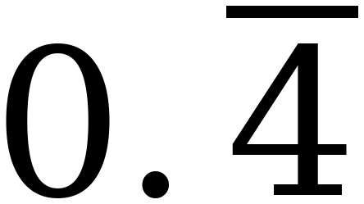
Whiteboards · Question 1 of 9
Boards up on three.
Write it as a fraction.
Simplify. Show the two lines you subtracted.
Grade 7 Accelerated · Unit 1 · Lesson 2 — Converting Between Repeating Decimals and Fractions
16

Slide 17
Whiteboards · Question 1 of 9
Answer.
10x − x = 4, so 9x = 4
Answer: 4/9
Grade 7 Accelerated · Unit 1 · Lesson 2 — Converting Between Repeating Decimals and Fractions
17

Slide 18
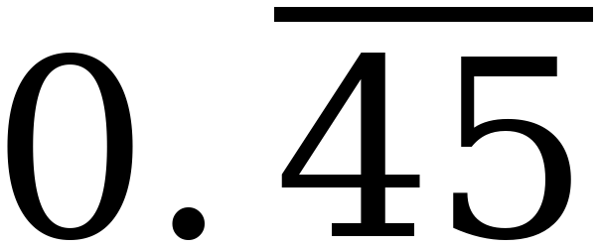
Whiteboards · Question 2 of 9
Boards up on three.
Write it as a fraction.
Simplify. Show the two lines you subtracted.
Grade 7 Accelerated · Unit 1 · Lesson 2 — Converting Between Repeating Decimals and Fractions
18

Slide 19
Whiteboards · Question 2 of 9
Answer.
100x − x = 45, so 99x = 45
Answer: 5/11
Grade 7 Accelerated · Unit 1 · Lesson 2 — Converting Between Repeating Decimals and Fractions
19

Slide 20
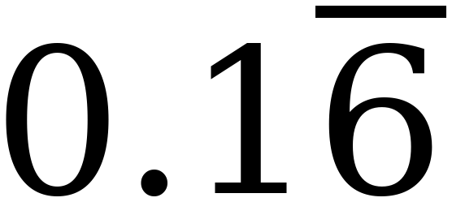
Whiteboards · Question 3 of 9
Boards up on three.
Write it as a fraction.
Simplify. Show the two lines you subtracted.
Grade 7 Accelerated · Unit 1 · Lesson 2 — Converting Between Repeating Decimals and Fractions
20

Slide 21
Whiteboards · Question 3 of 9
Answer.
100x − 10x = 15, so 90x = 15
Answer: 1/6
Grade 7 Accelerated · Unit 1 · Lesson 2 — Converting Between Repeating Decimals and Fractions
21

Slide 22
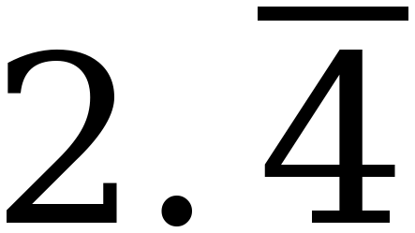
Whiteboards · Question 4 of 9
Boards up on three.
Write it as a fraction.
Simplify. Show the two lines you subtracted.
Grade 7 Accelerated · Unit 1 · Lesson 2 — Converting Between Repeating Decimals and Fractions
22

Slide 23
Whiteboards · Question 4 of 9
Answer.
the 2 comes along; 0.444… = 4/9
Answer: 22/9
Grade 7 Accelerated · Unit 1 · Lesson 2 — Converting Between Repeating Decimals and Fractions
23

Slide 24
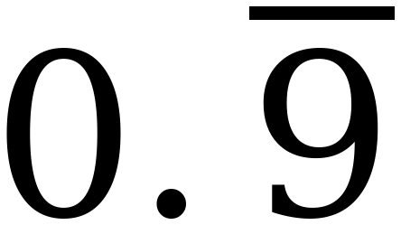
Whiteboards · Question 5 of 9
Boards up on three.
Write it as a fraction.
Simplify. Show the two lines you subtracted.
Grade 7 Accelerated · Unit 1 · Lesson 2 — Converting Between Repeating Decimals and Fractions
24

Slide 25
Whiteboards · Question 5 of 9
Answer.
10x − x = 9, so 9x = 9
Answer: 1
Grade 7 Accelerated · Unit 1 · Lesson 2 — Converting Between Repeating Decimals and Fractions
25

Slide 26
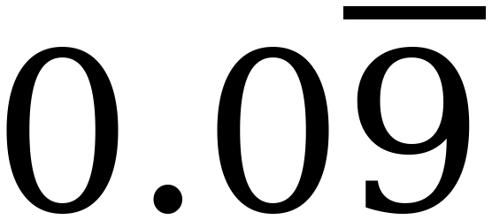
Whiteboards · Question 6 of 9
Boards up on three.
Write it as a fraction.
Simplify. Show the two lines you subtracted.
Grade 7 Accelerated · Unit 1 · Lesson 2 — Converting Between Repeating Decimals and Fractions
26

Slide 27
Whiteboards · Question 6 of 9
Answer.
one tenth of question 5
Answer: 1/10
Grade 7 Accelerated · Unit 1 · Lesson 2 — Converting Between Repeating Decimals and Fractions
27

Slide 28
Whiteboards · Question 7 of 9
Boards up on three.
x = 0.232323…
Which subtraction leaves a whole number?
10x − x 100x − x 100x − 10x
Grade 7 Accelerated · Unit 1 · Lesson 2 — Converting Between Repeating Decimals and Fractions
28

Slide 29
Whiteboards · Question 7 of 9
Answer.
x = 0.232323…
100x = 23.232323… and x = 0.232323…
Answer: 100x − x, which leaves 23
Grade 7 Accelerated · Unit 1 · Lesson 2 — Converting Between Repeating Decimals and Fractions
29

Slide 30
Whiteboards · Question 8 of 9
Boards up on three.
x = 0.123123123…
Which multiplier do you need?
Give the multiplier, and the whole number it leaves.
Grade 7 Accelerated · Unit 1 · Lesson 2 — Converting Between Repeating Decimals and Fractions
30

Slide 31
Whiteboards · Question 8 of 9
Answer.
x = 0.123123123…
three digits, so 1000x = 123.123123…
Answer: 1000x, leaving 123
Grade 7 Accelerated · Unit 1 · Lesson 2 — Converting Between Repeating Decimals and Fractions
31

Slide 32
Whiteboards · Question 9 of 9
Take your time. Boards up when you have written it.
Devon says 0.999… cannot equal 1, because it is always just a little bit under. Use today's method to settle it.
Write your answer in sentences.
This one is written work. Show the two lines you subtracted.
Grade 7 Accelerated · Unit 1 · Lesson 2 — Converting Between Repeating Decimals and Fractions
32

Slide 33
Whiteboards · Question 9 of 9
Answer.
Devon says 0.999… cannot equal 1, because it is always just a little bit under. Use today's method to settle it.
10x = 9.999…, so 10x − x = 9, so 9x = 9
Answer: x = 1, exactly
Grade 7 Accelerated · Unit 1 · Lesson 2 — Converting Between Repeating Decimals and Fractions
33

Slide 34
IXL
Last five minutes.
1.
Open IXL and start today's skills.
2.
Work on paper where the question needs work. The answer box does not show it.
3.
Whatever you do not finish is tonight's practice.
4.
The skills for today are posted in Google Classroom.
Grade 7 Accelerated · Unit 1 · Lesson 2 — Converting Between Repeating Decimals and Fractions
34

